Slide 1
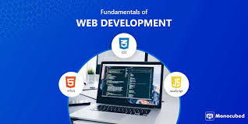
FUNDAMENTALS OF WEB DEVELOPMENT

Slide 2
Digital Portfolio
STUDENT NAME : ADHISTALAKSHMI.R
REGISTER No :24131081802521004
NMID : asanm10824131081802521004
DEPARTMENT : B.Sc.,Computer Science
COLLEGE :THIRU KOLANJIAPPAR GOVERNMENT ARTS COLLEGE ,VRIDHACHALAM

Slide 3
PROJECT TITLE
CREATIVE STUDENT PORTOFOLIO USING FWD

Slide 4
AGENDA
Problem statement
Project Overview
End Users
Tools and Technologies
Portfolio design and Layout
Features and functionality
Results and Screenshots
Conclusion
Githublink

Slide 5
PROJECT OVERVIEW
Portfolio contains About me , Projects , Skills , Contact and pictures

Slide 6
WHO ARE THE END USERS ?
STUDENTS
JOB SEEKERS
PROFESSIONALS
SOFTWARE EMPLOYEE

Slide 7
TOOLS AND TECHNIQUES
HTML – Pages, Sections
CSS-LAYOUT – COLOURS ,FONT
JAVASCRIPT-INTERACTIVE NAVIGATION,FORM VALIDATION

Slide 8
PORTFOLIO DESIGN AND LAYOUT
SECTION
HOME
PROJECETS
SKILLS
CONTACT
MOBILE / DESKTOP / TABLET

Slide 9
FEATURES AND FUNCTIONALITY
Navigation BAR with smoth scrolling
Image Details/ Hyperlinks
Interactive elements –Animations, Hover effects , Background colour change
Contact from validate

Slide 10
SCREEN SHOT
HTML

Slide 12
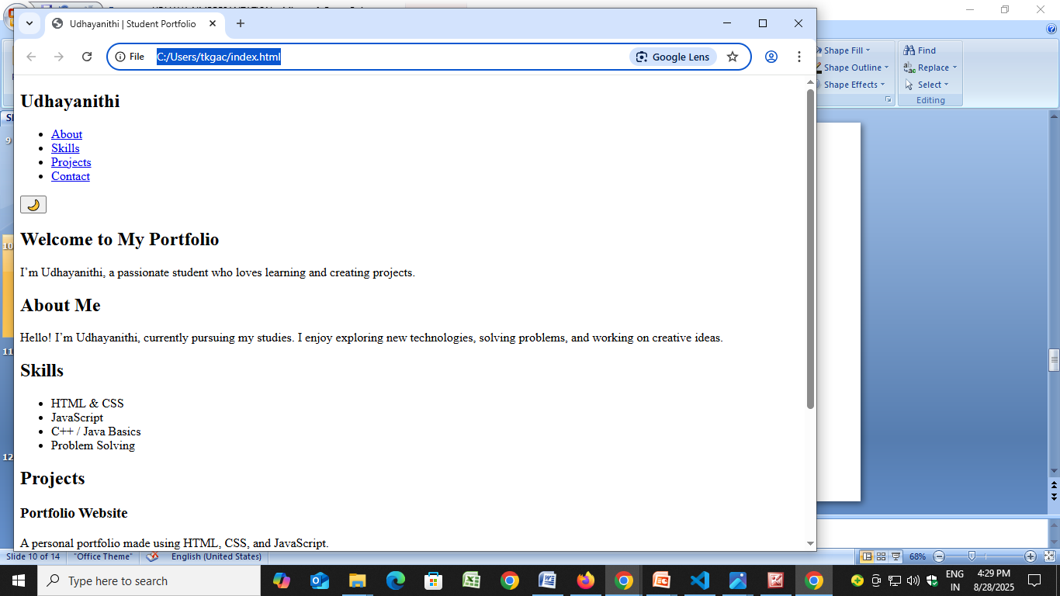

Slide 13
CONCLUSION
Easy to share With recruiters It makes Online presence

Slide 14
GITHUB LINK
https://github.com/ADHISTALAKSHMI

